Slide 1
DG INTERNS HUB
Cybersecurity Internship – Week 3
ADVANCED CYBERSECURITY PRACTICAL TASK
Submitted by: Gunn
Tools Used: Wireshark, Nmap

Slide 2
Project Objective
Authorized lab-based network security assessment
• Discover authorized hosts and exposed network services.
• Perform basic and advanced Nmap assessment.
• Capture and analyze network traffic with Wireshark.
• Correlate Nmap scan results with packet-level evidence.
• Identify security findings and classify risk.
• Apply hardening measures and verify improvement.
• Produce a professional final security assessment.
2

Slide 3
Scope, Authorization & Lab Environment
All testing is limited to owned or explicitly authorized systems
Authorized Lab
Network Data
Evidence
2–3 virtual machines
Kali Linux / Ubuntu / Windows
VirtualBox or VMware
IP address
Subnet & gateway
Lab VM addresses
Host discovery
Commands + results
Screenshots
PCAP analysis
Before/after verification
Safety Boundary
Do not scan random public IPs or third-party systems. Vulnerability testing and traffic analysis must remain inside the authorized lab.
3

Slide 4
Tools & Methodology
The practical workflow used across Tasks 7–14
Nmap
Wireshark
Virtualization
Discovery, ports, services, versions, OS and limited vulnerability scripts
Packet capture, protocol analysis and suspicious-activity investigation
Isolated 2–3 VM assessment environment
draw.io
GitHub
Network topology and architecture documentation
Project files, report, screenshots and README documentation
4

Slide 5
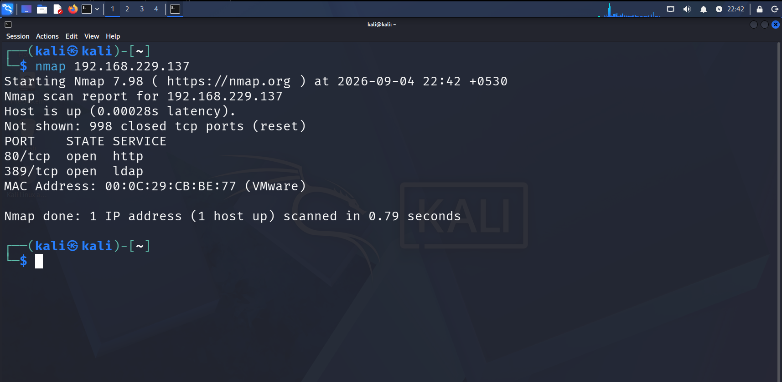
Task 7–8: Nmap Network Discovery & Advanced Assessment
• Identify IP address, subnet, gateway and authorized VM addresses.
• Host discovery: nmap -sn <lab-network>
• Basic scan: nmap <target-ip>
• Service/version detection: nmap -sV <target-ip>
• OS detection where supported: nmap -O <target-ip>
• TCP SYN scan: nmap -sS <target-ip>
• Limited UDP scan: nmap -sU --top-ports 20 <target-ip>
• NSE vulnerability scripts may be used only against authorized systems.
5

Slide 6
Nmap Results & Service Risk Analysis
Use actual lab results; example values from the assignment are not final evidence
Record
For Each Important Port
Assessment Output
IP address
Open ports
Protocol
Service
Detected version
Risk
Observation
What service is running?
Why is it required?
Is exposure necessary?
What happens if vulnerable?
How can it be secured?
Service exposure
Attack surface
Configuration concerns
Security recommendations
Evidence-backed conclusions
6

Slide 7
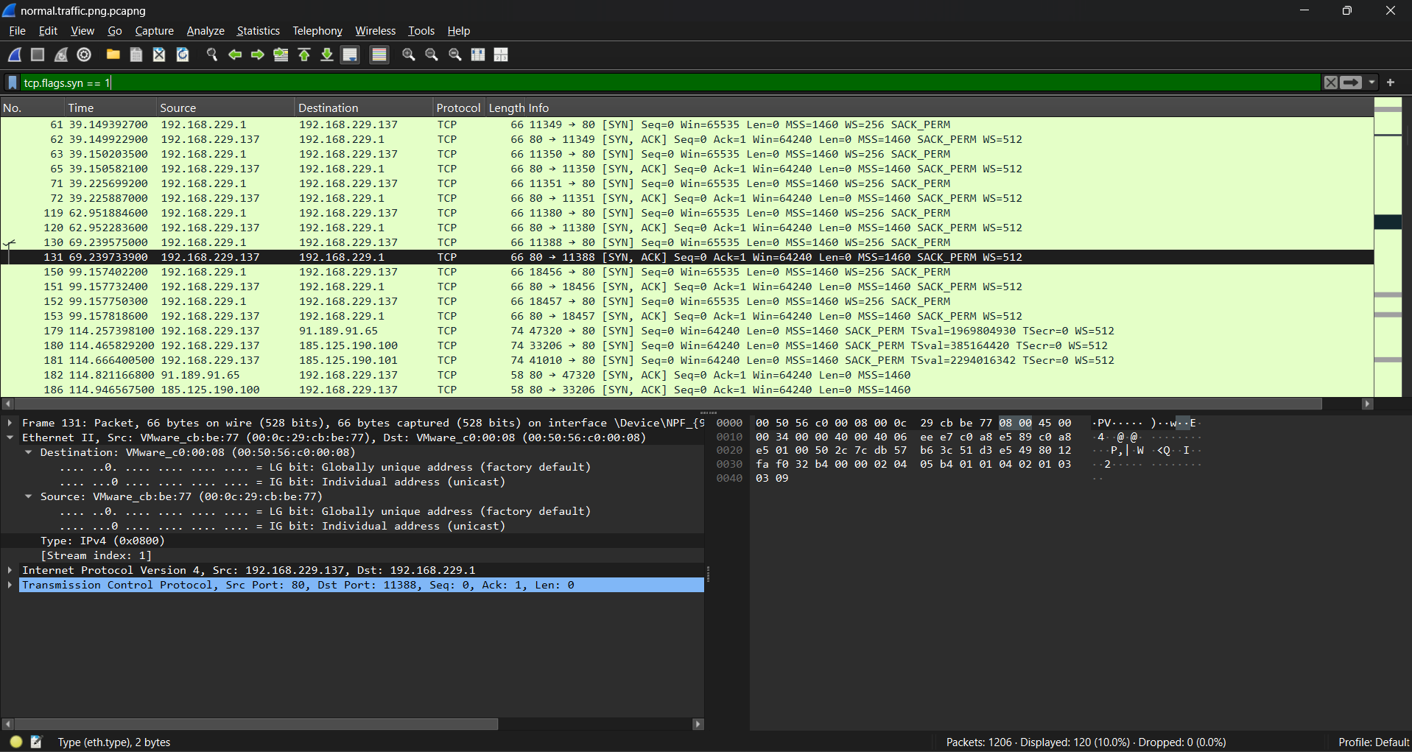
Task 9: Wireshark Network Traffic Capture
Capture normal authorized lab traffic for approximately 5–10 minutes
• Generate normal traffic: web access, DNS, ping and local service connections.
• Analyze DNS, TCP, UDP, ICMP, ARP and HTTP.
• Useful filters: dns, tcp, udp, icmp, arp.
• Investigate TCP SYN, TCP RST and unanswered DNS queries.
• Record timestamp, source/destination IP, ports, protocol and packet information.
• Document a security observation for important packets.
7

Slide 8
Task 10: Nmap + Wireshark Packet-Level Investigation
Understand how a SYN scan appears on the wire
Open Port
Closed Port
No Response
SYN → SYN/ACK
Service appears reachable
SYN → RST
Port is not accepting connection
No expected response
Possible filtering/firewall
• Run the authorized Nmap scan while Wireshark captures.
• Compare Nmap port status with packet sequence, TCP flags, source/destination and connection attempts.
• Record the relevant packet number and explain what occurred.
• Use actual captured results in the final comparison.
8

Slide 9
Task 11: Advanced Network Traffic Investigation
Analyze your own lab capture or a legitimate training PCAP/PCAPNG
• Top communicating hosts: identify most active sources, destinations and communication types.
• DNS investigation: queries, responses, requested domains and query types.
• TCP investigation: connections, SYN/SYN-ACK, RST and repeated attempts.
• Suspicious indicators: unusual ports, unexpected protocols, abnormal DNS, large traffic volumes or unexpected systems.
• Do not automatically label traffic malicious; explain the evidence and why it requires investigation.
• Document at least 5 interesting events in an investigation table.
9

Slide 10
Task 12: Vulnerability & Security Assessment
At least 5 findings derived from Tasks 7–11
Possible Findings
Risk Classification
Required Finding Record
Unnecessary open port
Unnecessary service
Outdated software
Insecure protocol
Weak configuration
Excessive exposure
Poor firewall configuration
Critical
High
Medium
Low
Severity must be justified using evidence and potential impact.
# / Finding
Evidence
Risk
Potential impact
Recommendation
Use actual findings—not sample values.
10

Slide 11
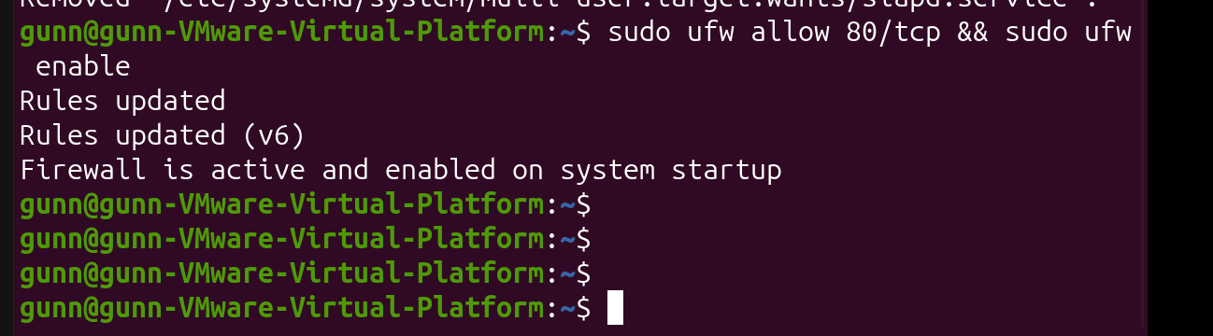
Task 13: Security Hardening
Implement at least 3 improvements and verify them
• Disable an unnecessary service.
• Close an unnecessary port.
• Configure firewall rules.
• Restrict a service to the local network.
• Update a vulnerable/outdated package.
• Improve service configuration or reduce network exposure.
• Run Nmap before and after the change and compare the attack surface.
PHOTO 3 — TASK 13 EVIDENCE
Paste hardening / before-after screenshot
11

Slide 12
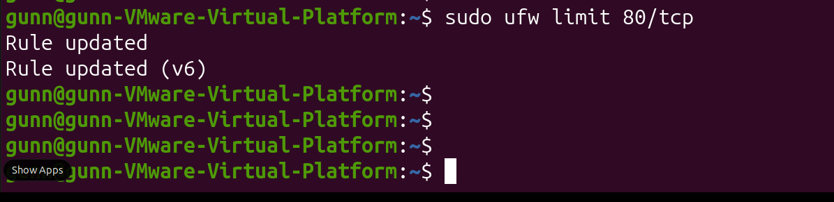
Task 14: Final Mini Security Assessment
Combine discovery, traffic analysis, findings and hardening
Network Discovery
Traffic Analysis
Security Assessment
Devices identified
Services exposed
Protocols observed
Communication patterns
Major findings
Highest risks
Supporting evidence
Hardening
Final Recommendation
Changes implemented
Before/after results
Provide 5 professional recommendations for improving the lab network and reducing attack surface.
PHOTO 4 — TASK 14
Paste final assessment evidence
12

Slide 13
Before vs After: Security Improvement
Show evidence that hardening reduced exposure or improved configuration
BEFORE
ACTION
AFTER
IMPROVEMENT
Original scan
Open services
Security issue
Evidence screenshot
Configuration change
Service disabled / port closed
Firewall or package update
Repeat scan
Changed exposure
Evidence screenshot
Reduced attack surface
Better configuration
Residual risk noted
13

Slide 14
Conclusion
Keep evidence organized and avoid sensitive data
• Project structure: 01-Nmap, 02-Wireshark, 03-Vulnerability-Assessment, 04-Hardening, Network-Diagram.
• Include Week-3-Report.pdf, Week-3-Presentation.pptx and README.md.
• README: objective, lab environment, tools, tasks, findings, improvements, before/after and conclusion.
• GitHu repository requirement: cybersecurity-week-3-network-security.
• Do not upload passwords, private keys, API keys, credentials or sensitive personal information.
• Recommendations: minimize exposed services, patch software, enforce firewall controls, restrict administrative access, continuously monitor traffic.
14

Slide 15
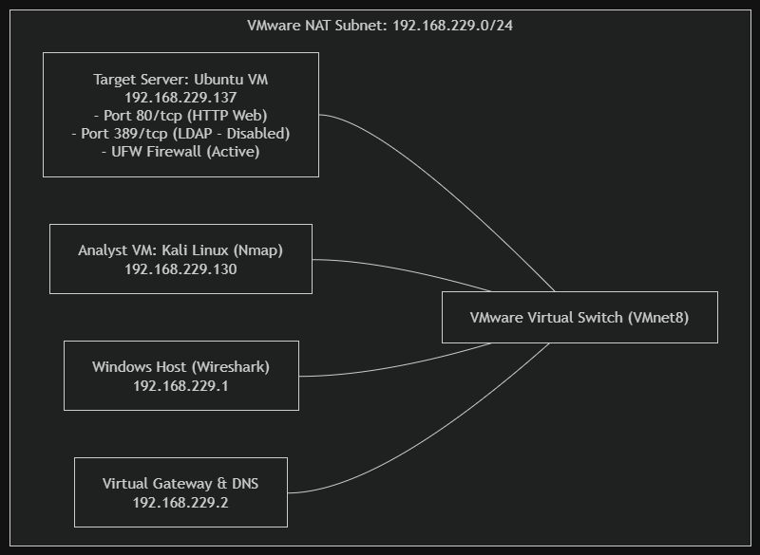
Network Topology
Insert your draw.io / diagrams.net topology here
15

